Slide 1
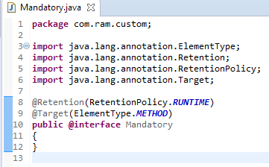
Define custom @Required-style annotation in Spring
The @Required annotation is used to make sure a particular property has been set.
Spring is allows to define your custom @Required-style annotation, which is equivalent to @Required annotation.
Custom @Required-style annotation named @Mandatory, which is equivalent to @Required annotation.

Slide 2
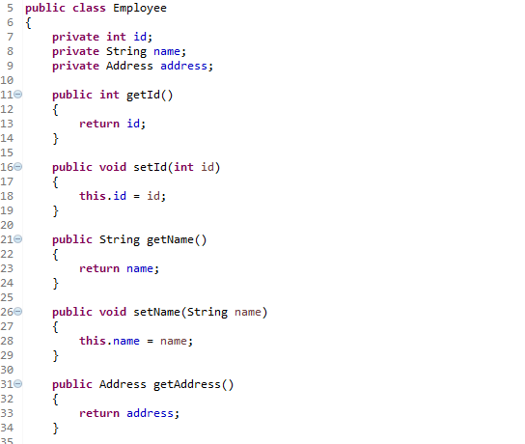
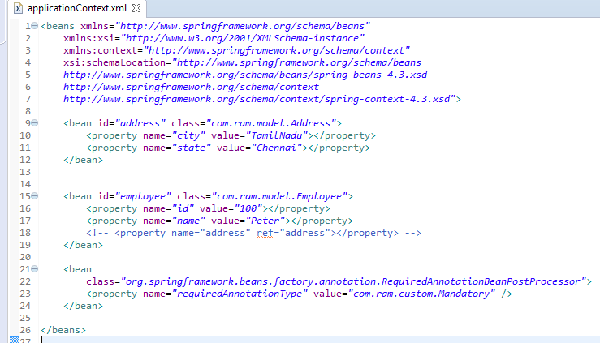
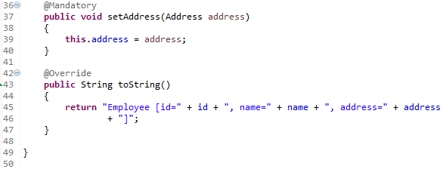
Define custom @Required-style annotation in Spring
A Employee object, apply @Mandatory in setAddress() method to make sure the person property has been set.
Register @Mandatory annotation in ‘RequiredAnnotationBeanPostProcessor’ class.
We created a new custom @Required-style annotation named @Mandatory, which is equivalent to @Required annotation.

Slide 3
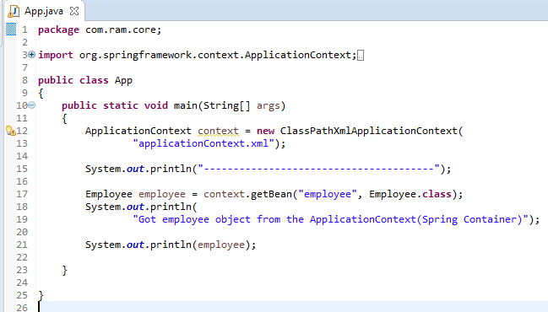
Define custom @Required-style annotation in Spring

